Slide 1




Luca
Emma
Mei
Raj

Slide 2
Which describes Mei best?
Indulgent
Restraint

Slide 3
Which fits Raj style?
High Uncertainty Avoidance
Low Uncertainty Avoidance

Slide 4
How would you describe Luca?
Collectivist
Individualist

Slide 5
How does Emma approach leadership?
High Power Distance
Low Power Distance

Slide 6
What’s Mei’s focus?
Long-term Orientation
Short-term Orientation

Slide 7
What do you think?
Masculine culture
Feminine culture

Slide 8
Cultural Dimensions at Work:
Hofstede’s Theory

Slide 9
Lesson Outcomes:
Identify and interpret key workplace behaviors through the lens of Hofstede’s Cultural Dimensions Theory.
Reflect on and connect Hofstede’s model to their own team dynamics.

Slide 10

Raj and Emma discuss the team’s next campaign. Emma proposes highlighting the company’s legacy and past wins. Raj pushes a message centered on innovation and potential.

Slide 11
Suddenly, shocking news: one of the team members quits! Raj wants to rewrite the entire project plan. Emma suggests reassigning tasks on the fly and adjusting deadlines later.

Slide 12
High uncertainty avoidance vs
Low uncertainty avoidance
Long-term vs Short-term orientation

Slide 13
High uncertainty avoidance vs
Low uncertainty avoidance
Long-term vs. Short-term orientation
What are the benefits of each approach in the workplace?
Have you seen these mindsets in your team or organization?

Slide 14

Luca informs the team
that he quits!
He got a new position
in a different country.

Slide 15
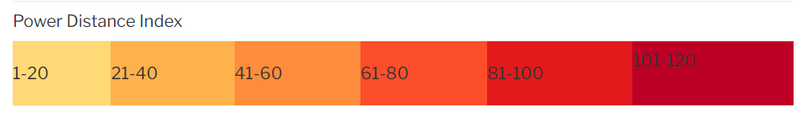



Germany
Mexico
Sweden

Slide 16
Power Index
- What Power Index do these countries have?
- What do you think about the representation of collectivism vs. individualism in these countries?

Slide 17

Power Index

Slide 18
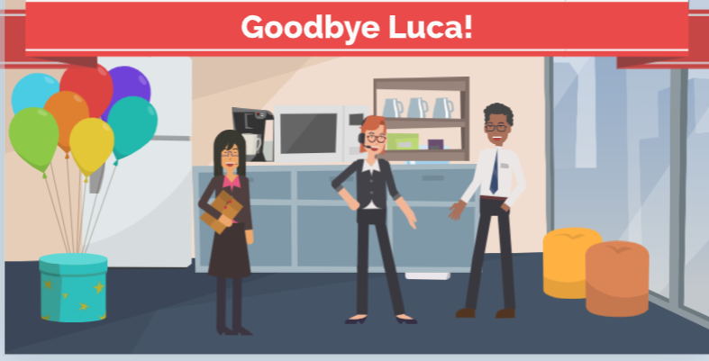

Slide 19
Individulaist vs Collectivist
Indulgent vs. Restraint
Power Distance
Luca is leaving the company.
Mei wants a fun party.
Raj prefers a formal
thank-you email.

Slide 20
Individulaist vs Collectivist
Uncertainty Avoidance
Masculinity vs. Femininity
Raj wants to give Luca a
trophy for performance.
Emma suggests a small
lunch to say thanks.

Slide 21
Masculinity vs. Femininity
Create a quick 1-2 minute workplace conflict involving your assigned dimension. Keep it simple – what’s the issue and response.
Indulgent vs. Restraint

Slide 22
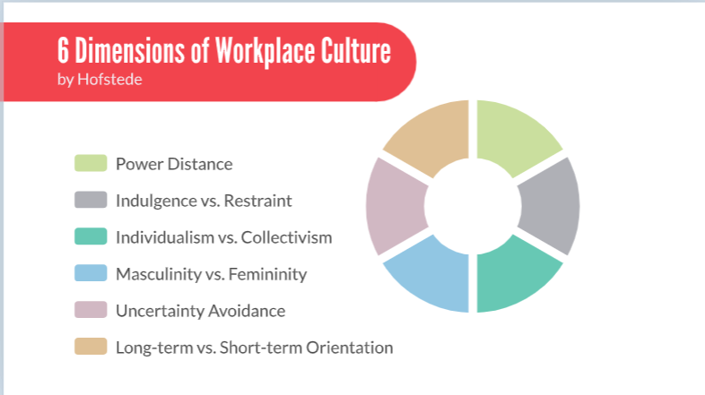

Slide 23
Lesson Outcomes:
Identify and interpret key workplace behaviors through the lens of Hofstede’s Cultural Dimensions Theory.
Reflect on and connect Hofstede’s model to their own team dynamics.

Slide 24
Reflective Writing
• Reflect on a cultural misunderstanding and apply Hofstede’s model
• Interview a colleague about their work style—identify a dimension
• Describe how one dimension appears in your current workplace

Slide 25
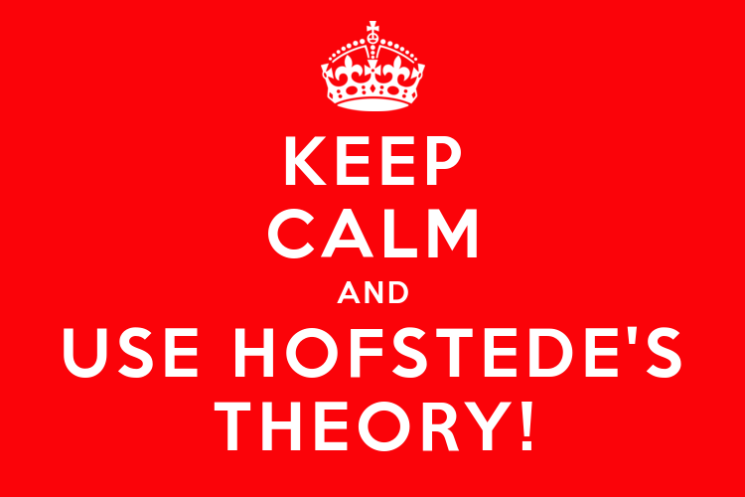
Thank you!

